Slide 1
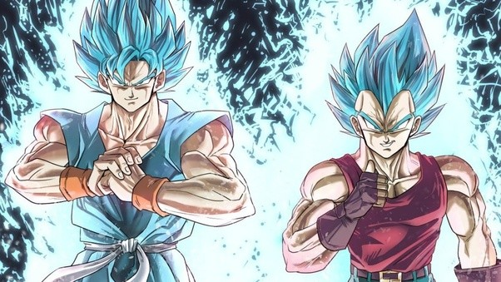
GifBall-Z
The Battle You Didn’t Know You Needed to Join

Slide 2
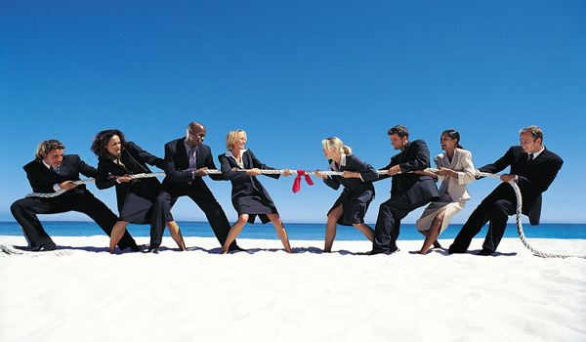
We Make a Competition Out of Everything

Slide 3
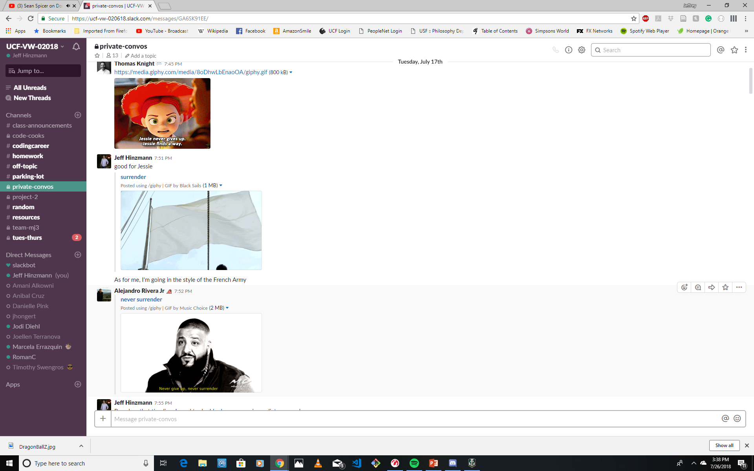
Even Gifs…

Slide 4
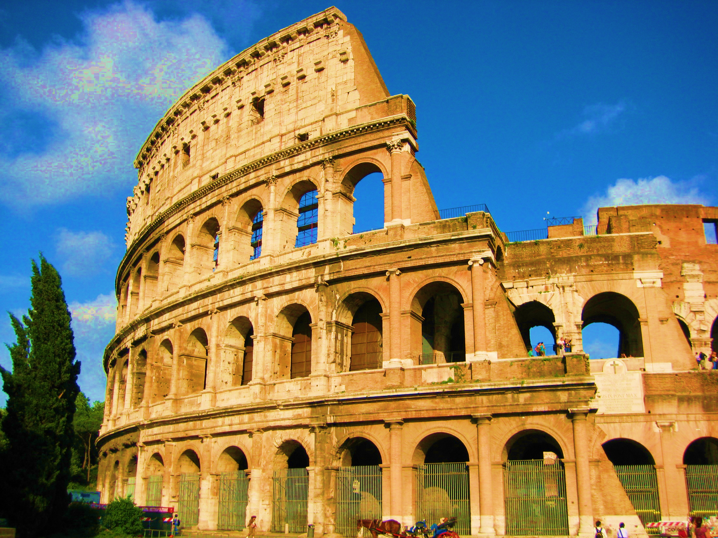
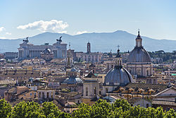
So when in Rome…

Slide 5
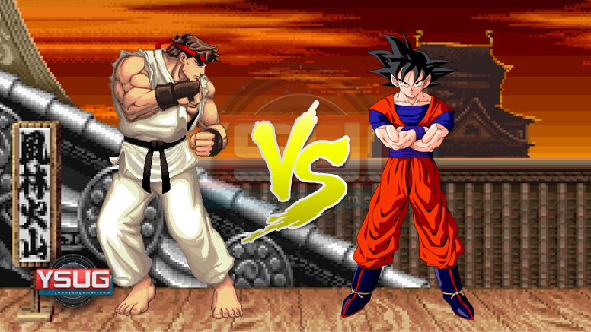
Embrace the Battle with GifBall-Z

Slide 6
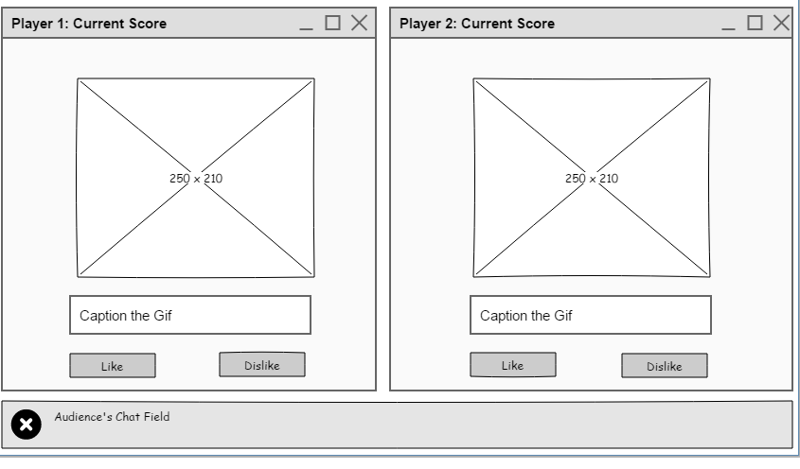
How it works:
Two players battle before an audience
The battle is organized around a theme, and a common API call.
The audience then votes on the quality of the caption provided
The Gif/caption combo that receives the most votes is the winner.
The match can by a timer or a set number of Gifs
Most wins within the match wins the match.

Slide 7
Specification:
Front-End:
React
React-Bootstrap
Back-End:
Firebase (including chat functionality)
Conversion to MongoDB possible

Slide 8
Stretch Goals Include:
Making it work
Deploy to Heroku
Multiple game modes
Gif selection & Gif captioning
Enhanced UI with game event effects

